Slide 1
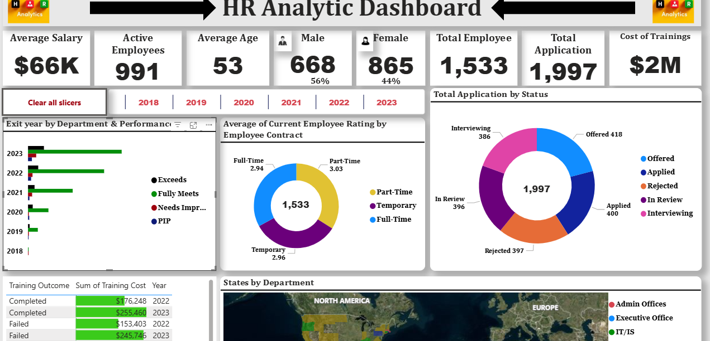
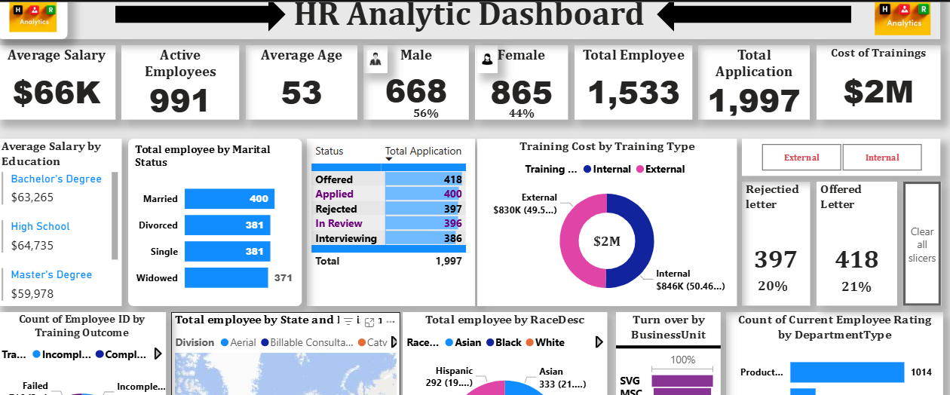
HR DASHBOARD REPORT 2025

Slide 2

Project Summary
In this HR data analysis project using Power BI, I extracted insights from three text files: employee data, training and development, and recruitment.
After data cleaning, I used DAX to create measures and KPIs.
Visuals included average salary, active staff, gender distribution, training costs, recruitment outcomes, and workforce breakdowns by state, race, marital status, department, and performance.

Slide 3

Data Cleaning/Preparation
In the initial data preparation phase, we performed the following task;
Data Loading and inspection
Handling missing values
Removing blank rows and unwanted columns
Data Cleaning and formatting
This Photo by Unknown Author is licensed under CC BY-SA

Slide 4

Exploratory Data Analysis
10 Key Exploratory question from HR data set, such as:
Here are 10 key questions this Power BI project aims to answer:
What is the average salary across departments?
How many active employees are there?
What is the gender distribution among employees?
What is the total cost of training provided?
How many offer letters and rejection letters were issued?
How many employees are there by marital status?
What is the racial distribution of employees?
How do employee ratings vary by department?
What is the employee count by state and division?
How many applications fall under each recruitment status?

Slide 5

Results/Findings
The analysis of results are summarized as follows:
The HR Analytic Dashboard provides key insights into the workforce.
The average salary is $66K for 991 active employees with an average age of 53.
The gender distribution is 668 males (56%) and 865 females (44%), totaling 1,533 employees.
The total cost of training is $2M, and there were 1,997 total applications.
Analysis includes exit trends by department, average employee contract types, application status, training outcomes ($1.67M total cost), and employee distribution across states and departments.

Slide 6

Recommendation
Based on the analysis, we recommend the following actions:
Based on the HR data, investigate gender distribution in applications and analyse "Needs Improvement" exits to improve retention.
Evaluate training cost-effectiveness across different outcomes. Further explore employee distribution within specific departments for better resource allocation and workforce planning.

